Slide 1
Machine Learning
Lecture L15b:
Convolutional Neural Network
Dr. Beilun Wang
Southeast University
School of Computer Science
and Engineering

Slide 2
Today: Deep Learning
History
Convolutional Neural Network

Slide 3
Early History
In 1950, English mathematician Alan Turing wrote a landmark paper titled “Computing Machinery and Intelligence” that asked the question: “Can machines think?”
Further work came out of a 1956 workshop at Dartmouth sponsored by John McCarthy. In the proposal for that workshop, he coined the phrase a “study of artificial intelligence”
1950s
Samuel’s checker player : start of machine learning
Selfridge’s Pandemonium

Slide 4
Early History
1952-1969: Enthusiasm: Lots of work on neural networks
1970s-80s: Expert systems, Knowledge bases to add on rule-based inference, Decision Trees, Bayes Nets
1990s: CNN, RNN, ….
2000s: SVM, Kernel machines, Structured learning, Graphical models, semi-supervised, matrix factorization, …

Slide 5
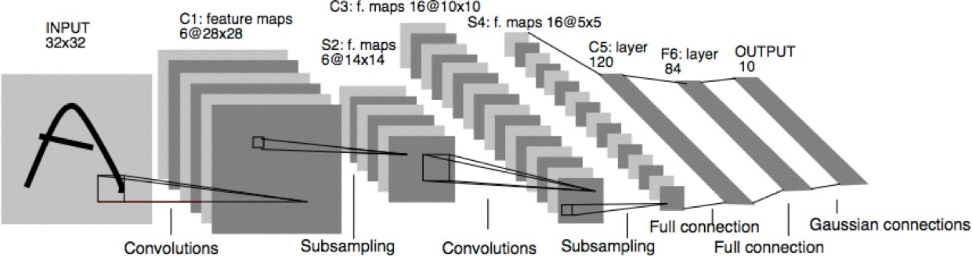
Deep Learning (CNN) in the 90’s
Prof. Yann LeCun invented Convolutional Neural Networks (CNN) in 1998
First NN successfully trained with many layers
Y. LeCun, L. Bottou, Y. Bengio, and P. Haffner, Gradient-based learning applied to document recognition, Proceedings of the IEEE 86(11): 2278–2324, 1998.

Slide 6
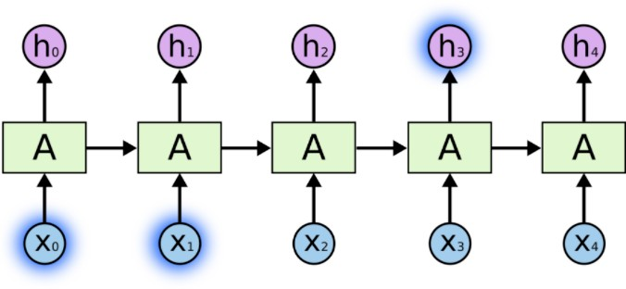
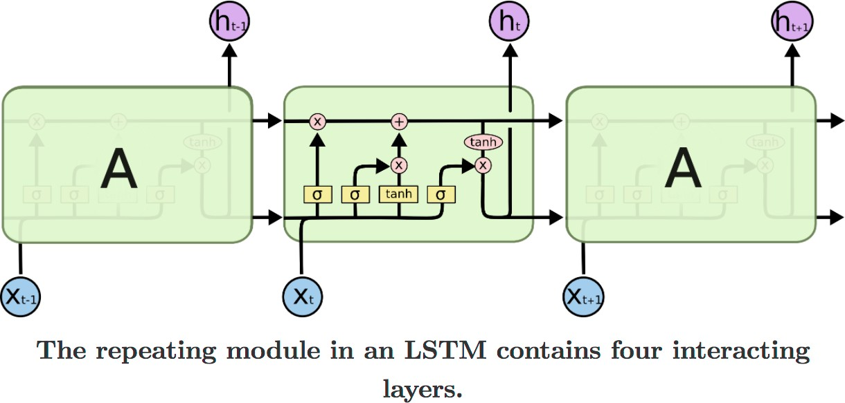
Deep Learning (RNN) in the 90’s
Prof. Schmidhuber invented "Long short-term memory” – Recurrent NN (LSTM-RNN) model in 1997
Sepp Hochreiter; Jürgen Schmidhuber (1997). "Long short-term memory". Neural Computation. 9 (8): 1735–1780.

Slide 7
“Winter of Neural Networks” in~2000s
Non-convex
Need a lot of tricks to play with
How many layers?
How many hidden units per layer?
What topology among layers?
…
Hard to perform theoretical analysis
Large labeled datasets are rare

Slide 8
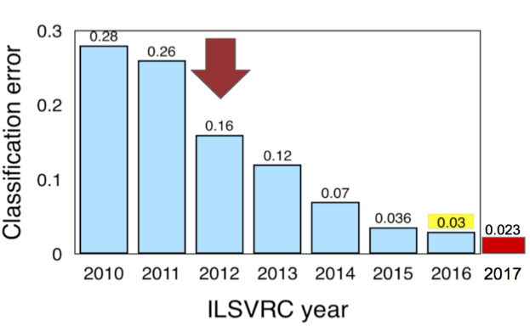
ImageNet Challenge
2010-11: hand-crafted computer vision pipelines
2012-1016: ConvNets
2012: AlexNet
Major deep learning success
2013: ZFNet
Improvements over AlexNet
2014
VGGNet:deeper,simpler
InceptionNet:deeper,faster
2015
ResNet: even deeper
2016
Ensembled networks
2017
Squeeze and Excitation Network

Slide 9
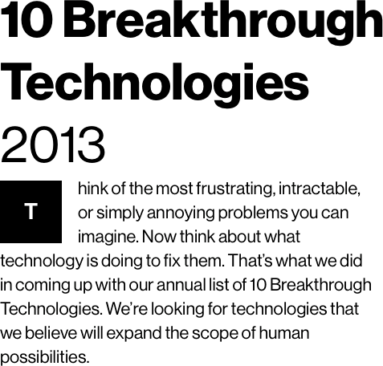
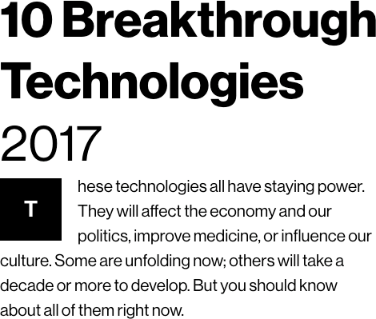


Deep Learning
Deep Reinforcement Learning
Generative Adversarial Network (GAN)
Why breakthrough ?

Slide 10
DNNs help us build more intelligent computers
Perceive the world,
e.g., objective recognition, speech recognition, …
Understand the world,
e.g., machine translation, text semantic understanding
Interact with the world,
e.g., AlphaGo, AlphaZero, self-driving cars, …
Being able to think / reason,
e.g., learn to code programs, learn to search deepNN, …
Being able to imagine / to make analogy,
e.g., learn to draw with styles, ……

Slide 11
Some Recent Trends
1. CNN / Residual / Dynamic parameter
2. RNN / Attention / Seq2Seq / BERT …
3. Neural Architecture with explicit Memory
4. Learning to optimize / Learning DNN architectures
5. Autoencoder / layer-wise training
6. Learning to learn / meta-learning/ few-shots
7. DNN on graphs / trees / sets
8. NTM 4program induction / sequential decisions
9. Generative Adversarial Networks (GAN)
10. Deep Generative models, e.g., autoregressive
11. Deep reinforcement learning
12. Validate / Evade / Test / Understand / Verify DNNs
New Network topology
New Losses
New Inputs
New Tasks
New Model Properties

Slide 12
Today: Deep Learning
History
Convolutional Neural Network

Slide 13
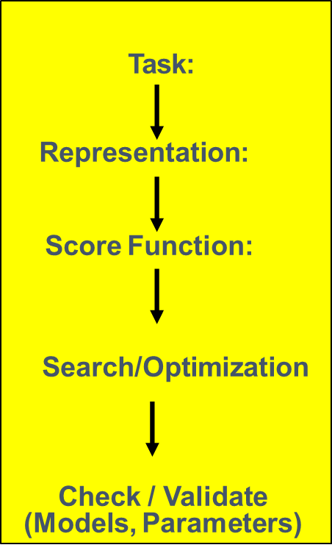
Machine (Deep) Learning in a Nutshell

Slide 14
A nutshell of Variations in Deep NN: Five Aspects
Tasks:
Discriminative prediction / Generative / Reinforce / Reasoning
Formulate Input / Output:
Data representation
Architecture Design:
Network Topology, Network Parameters
Training / Searching / Learning
With new losses
With new optimization tricks
New formulation of learning
Scaling up with GPU, Scaling up with distributed optimization , e.g. Asynchronous SGD
Validation / Trust / Test / Understand …
Software 2.0

Slide 15
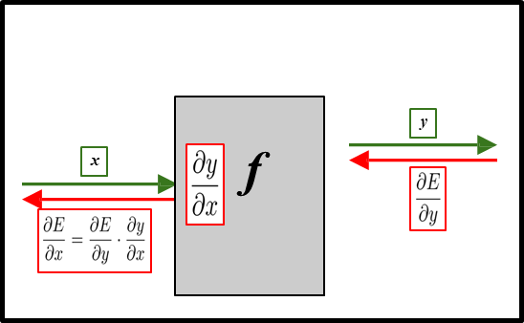
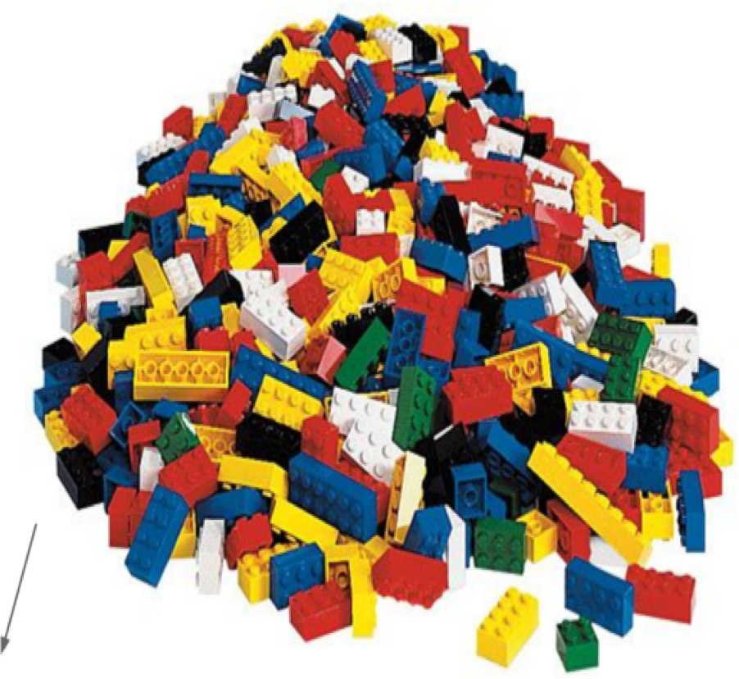
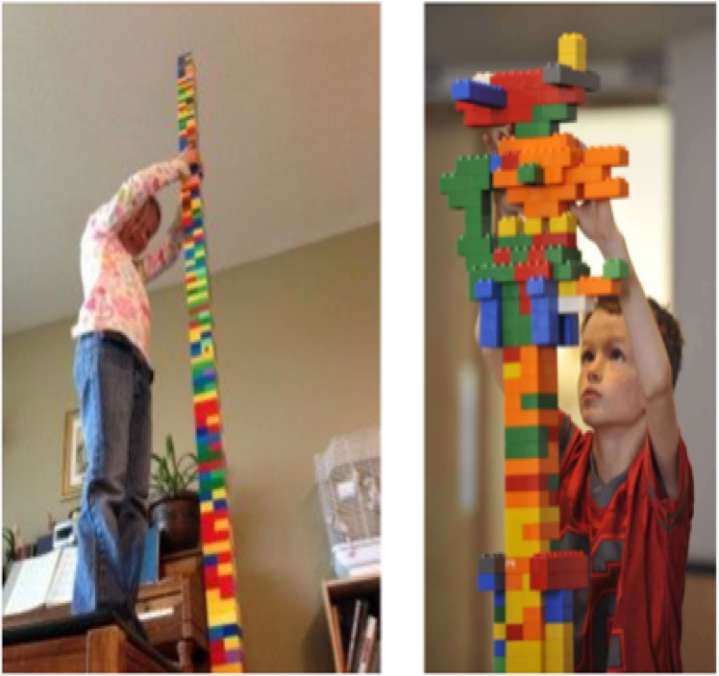
Building Deep Neural Nets

Slide 16
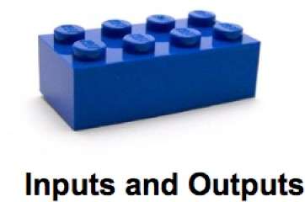
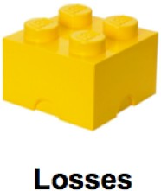
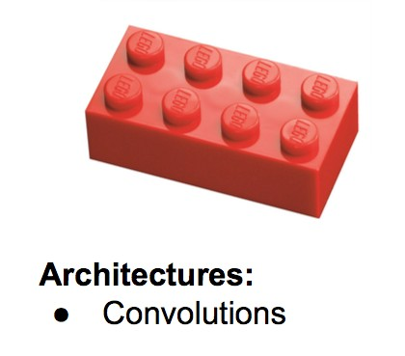

Today’s Survey: Trends since ~2011
Software 2.0
Validation

Slide 17
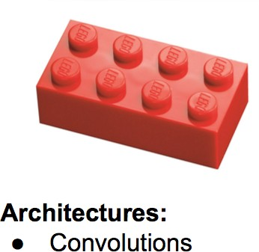
Recent Trend (1)
Convolutional Neural Networks
(aka CNNs and ConvNets)

Slide 18
Machine (Deep) Learning in a Nutshell
New Network Topology, Network Parameters

Slide 19
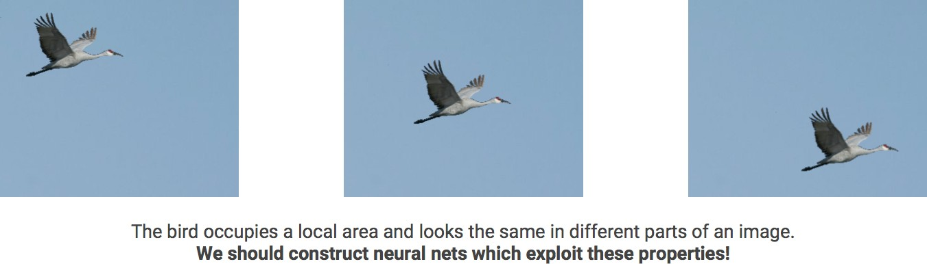
Important Block: Convolutional Neural Networks
Prof. Yann LeCun invented CNN in 1998
First NN successfully trained with many layers

Slide 20
Locality and Translation Invariance
Locality: objects tend to have a local spatial support
Translation invariance: object appearance is independent of location
Can define these properties since an image lies on a grid / lattice
ConvNet machinery applicable to other data with such properties, e.g. audio/text

Slide 21


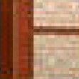

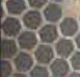








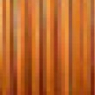

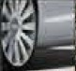
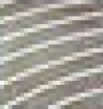
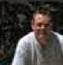









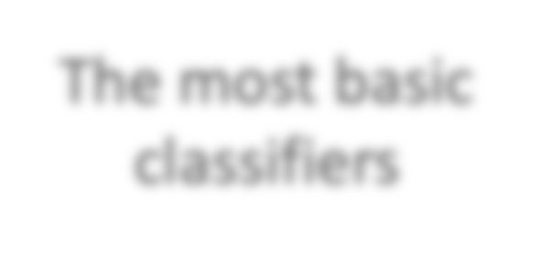
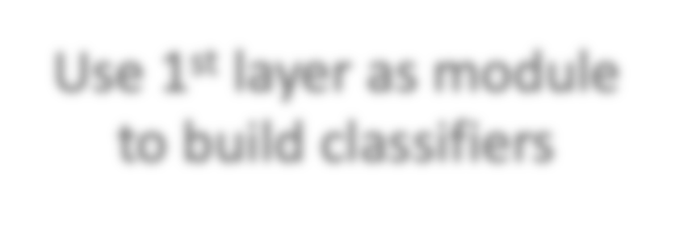
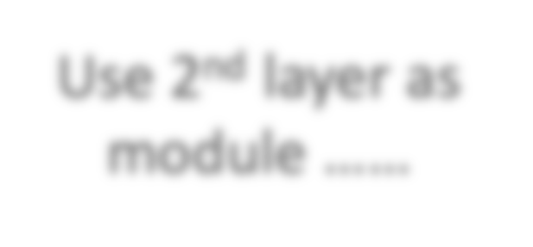
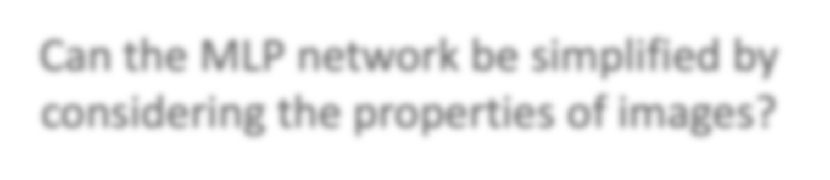


Why CNN for Image
x₁
……
……
x₂
……
……
……
……
Represented as pixels
x_{N}
……
The most basic classifiers
Use 1st layer as module to build classifiers
Use 2nd layer as module ……
Can the MLP network be simplified by considering the properties of images?

Slide 22
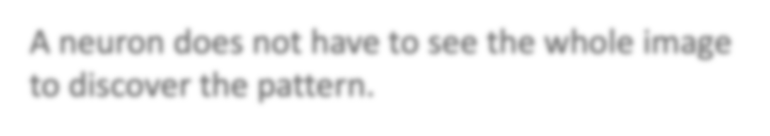


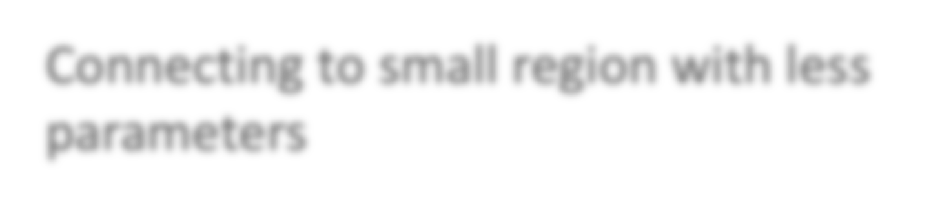



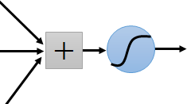
Why CNN for Image
(1) Locality: Some patterns are much smaller than the whole image
A neuron does not have to see the whole image to discover the pattern.
Connecting to small region with less parameters
“beak” detector

Slide 23

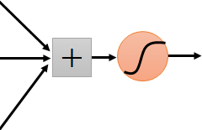


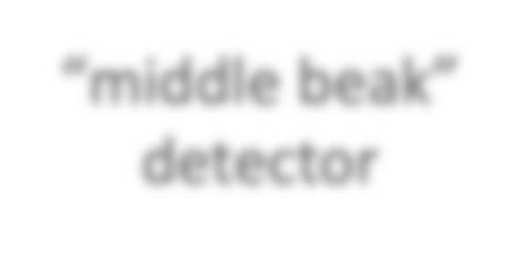
Why CNN for Image
(2) Translation invariance: The same patterns appear in different regions.
𝑥⃗_{𝑠}
“upper-left beak” detector
𝑤_{𝑠}
Do almost the same thing
They can use the same set of parameters.
𝑤_{𝑠}
“middle beak” detector

Slide 24

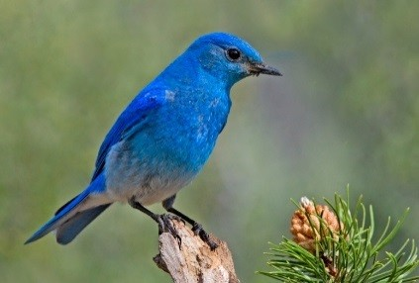
Why CNN for Image
(3) Subsampling the pixels will not change the object
bird
bird
subsampling
We can subsample the pixels to make image smaller
Less parameters for the network to process the image

Slide 25

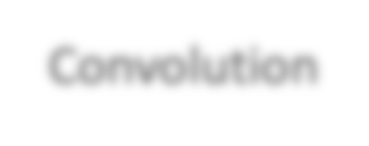

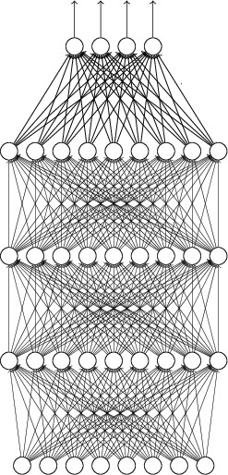
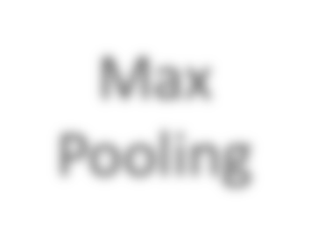


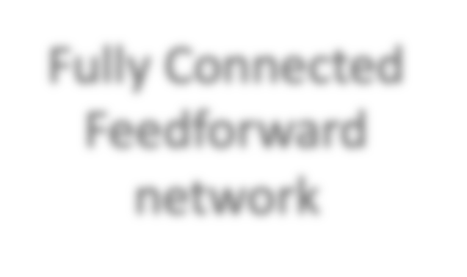



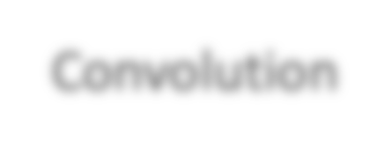



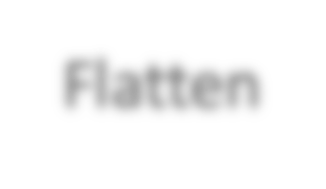


The whole CNN
cat dog ……
Convolution
Max Pooling
Can repeat many times
Fully Connected Feedforward network
Convolution
Max Pooling
Flatten

Slide 26






The whole CNN
Property 1
Some patterns are much smaller than the whole image
Convolution
Property 2
Max Pooling
The same patterns appear in different regions.
Can repeat many times
Property 3
Convolution
Subsampling the pixels will not change the object
Max Pooling
Flatten
Flatten

Slide 27
The whole CNN
cat dog ……
Convolution
Max Pooling
Can repeat many times
Fully Connected Feedforward network
Convolution
Max Pooling
Flatten

Slide 28


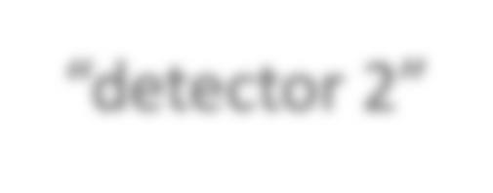
CNN – Convolution
Those are the network parameters to be learned.
“detector 1”
Filter 1
Matrix _{𝑤𝑠1}
1 | -1 | -1
-1 | 1 | -1
-1 | -1 | 1
1 | 0 | 0 | 0 | 0 | 1
0 | 1 | 0 | 0 | 1 | 0
0 | 0 | 1 | 1 | 0 | 0
1 | 0 | 0 | 0 | 1 | 0
0 | 1 | 0 | 0 | 1 | 0
0 | 0 | 1 | 0 | 1 | 0
-1 | 1 | -1
-1 | 1 | -1
-1 | 1 | -1
Filter 2
Matrix
^{𝑤}𝑠2
“detector 2”
6 x 6 image
…
…
Property 1
Each filter detects a small pattern (3 x 3).

Slide 29

CNN – Convolution
1 | -1 | -1
-1 | 1 | -1
-1 | -1 | 1
Filter 1
stride=1
1 | 0 | 0 | 0 | 0 | 1
0 | 1 | 0 | 0 | 1 | 0
0 | 0 | 1 | 1 | 0 | 0
1 | 0 | 0 | 0 | 1 | 0
0 | 1 | 0 | 0 | 1 | 0
0 | 0 | 1 | 0 | 1 | 0
3
6 x 6 image

Slide 30

CNN – Convolution
1 | -1 | -1
-1 | 1 | -1
-1 | -1 | 1
Filter 1
stride=1
1 | 0 | 0 | 0 | 0 | 1
0 | 1 | 0 | 0 | 1 | 0
0 | 0 | 1 | 1 | 0 | 0
1 | 0 | 0 | 0 | 1 | 0
0 | 1 | 0 | 0 | 1 | 0
0 | 0 | 1 | 0 | 1 | 0
3
-1
6 x 6 image

Slide 31
CNN – Convolution
1 | -1 | -1
-1 | 1 | -1
-1 | -1 | 1
Filter 1
stride=2
1 | 0 | 0 | 0 | 0 | 1
0 | 1 | 0 | 0 | 1 | 0
0 | 0 | 1 | 1 | 0 | 0
1 | 0 | 0 | 0 | 1 | 0
0 | 1 | 0 | 0 | 1 | 0
0 | 0 | 1 | 0 | 1 | 0
3
-3
We set stride=1 below
6 x 6 image

Slide 32
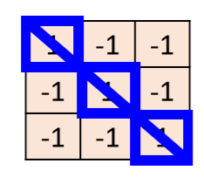
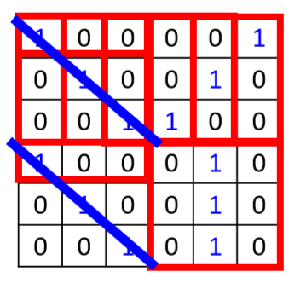
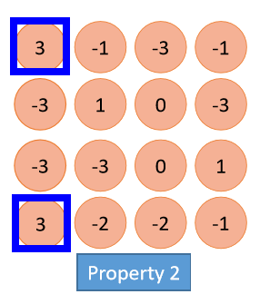
CNN – Convolution
“detector 1”
Filter 1
stride=1
6 x 6 image

Slide 33
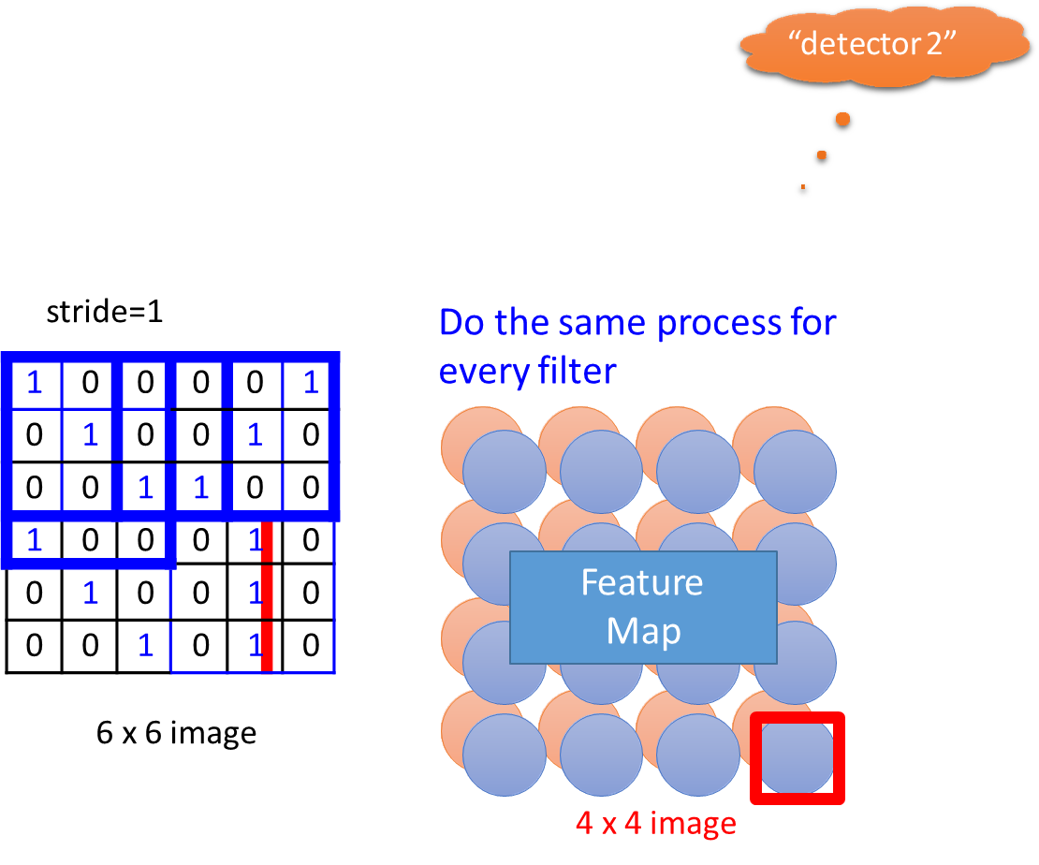
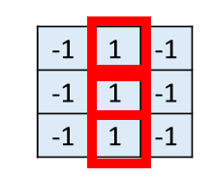
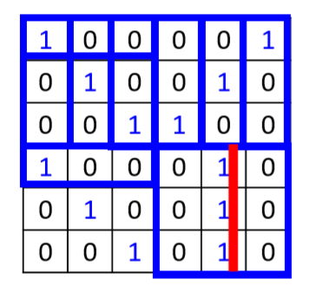
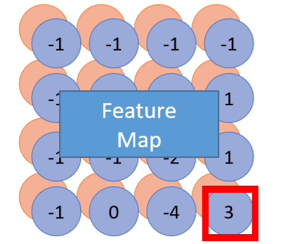
CNN – Convolution
Filter 2

Slide 34
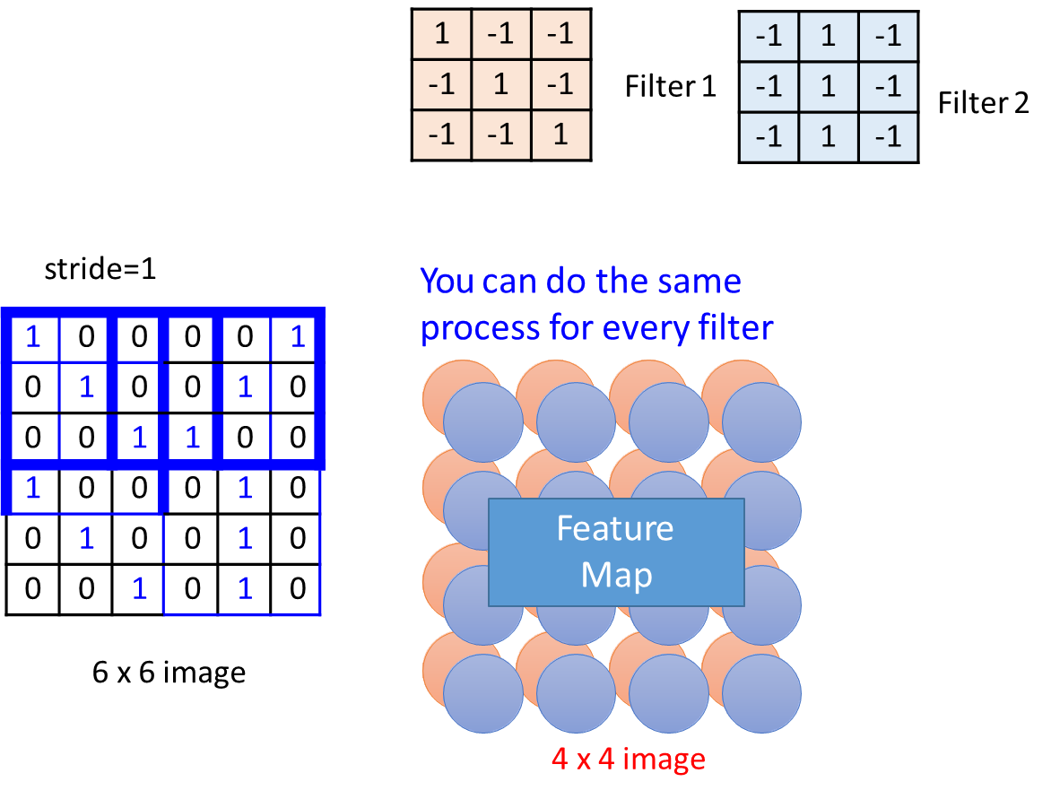
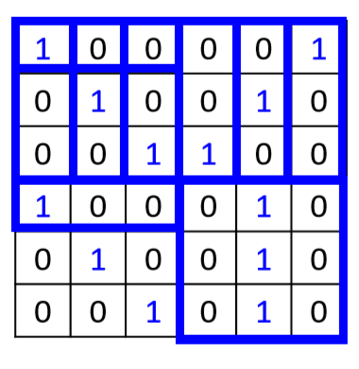
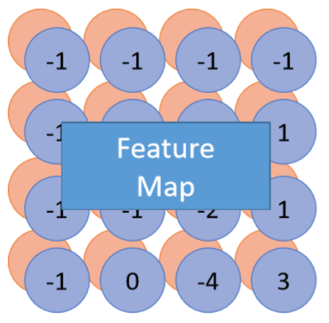
CNN – Convolution

Slide 35
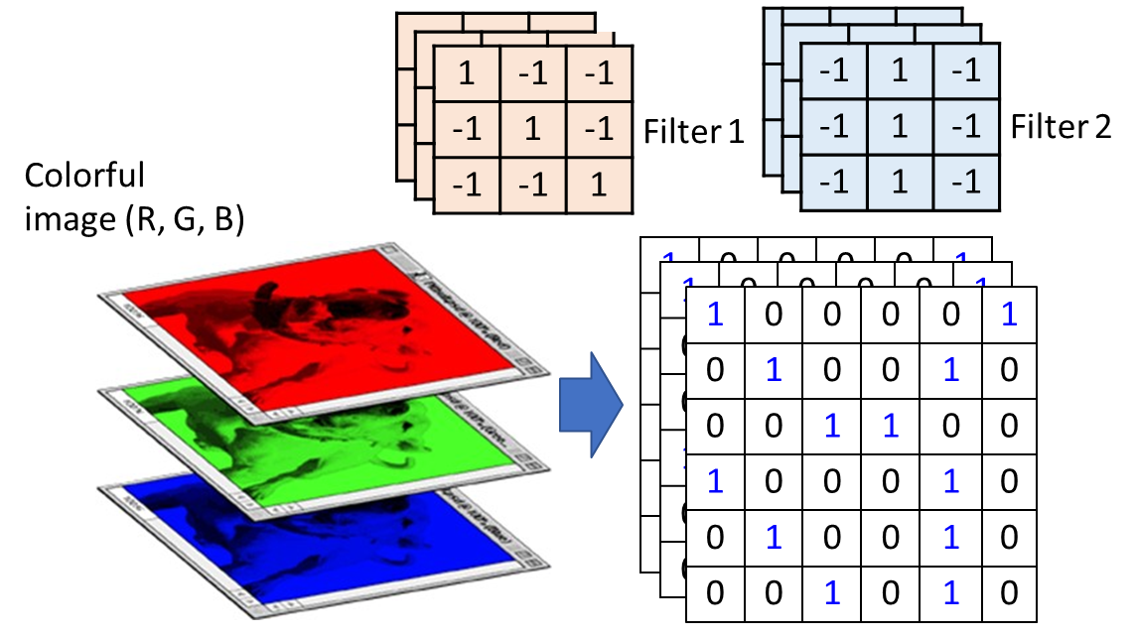
CNN – Colorful image (from matrix to tensor)

Slide 36
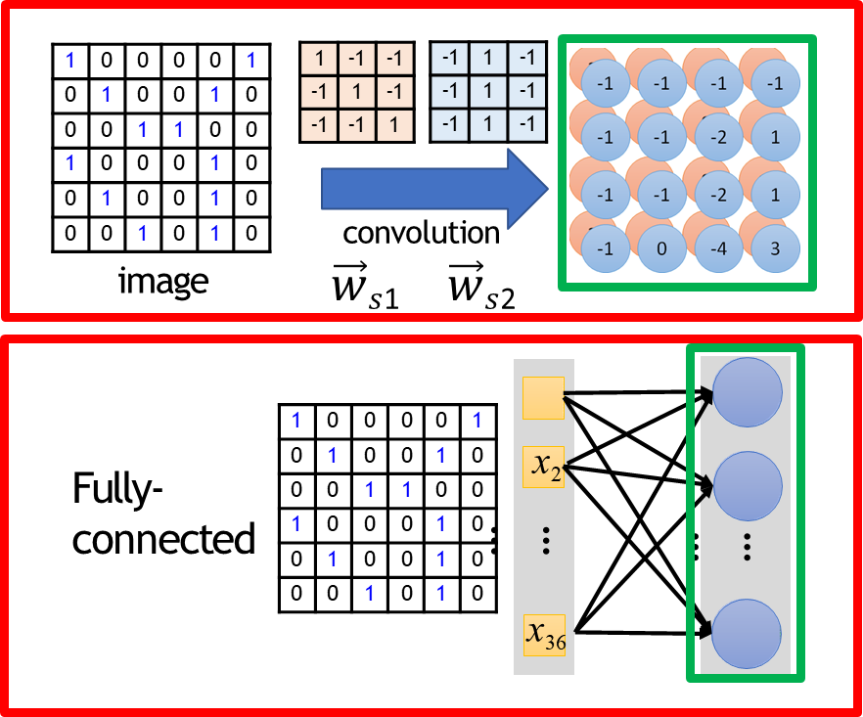
Convolution v.s. Fully Connected
When with 2 filters, 3*3*2=18 parameters!
When 2 filters, 36*2=72 parameters!

Slide 37

(1) Locality:
Each filter has 3*3=9 parameters!

Slide 38

(2) Translation invariance:

Slide 39
The whole CNN
cat dog ……
Convolution
softmax
Max Pooling
Can repeat many times
Fully Connected Feedforward network
Convolution
Max Pooling
Flatten

Slide 40


(3) Subsampling:
CNN – Max Pooling

Slide 41


(3) Subsampling:
CNN – Max Pooling

Slide 42


(3) Subsampling:
CNN – Max Pooling

Slide 43

(3) Subsampling:
CNN – Max Pooling

Slide 44


The whole CNN

Slide 45

The whole CNN

Slide 46

Flatten

Slide 47


CNN in Keras

Slide 48



CNN in Keras

Slide 49

Application: Playing Go

Slide 50

Application: Speech

Slide 51

Fast-forward to today: ConvNets are everywhere

Slide 52

Fast-forward to today: ConvNets are everywhere

Slide 53

Fast-forward to today: ConvNets are everywhere

Slide 54

Residual Trick:

Slide 55

Revolution of Depth

Slide 56


Slide 57
Adaptive / Dynamic Trick:
https://qiyanjun.github.io/2019f-UVA-CS6316-MachineLearning/
Hyper Networks, ICLR 2017
Optimal Architectures in a Solvable Model of Deep Networks, NIPS16
AdaNet: Adaptive Structural Learning of Artificial Neural Networks, ICML17
SplitNet: Learning to Semantically Split Deep Networks for Parameter Reduction and Model Parallelization, ICML17
Image Question Answering using Convolutional Neural Network with Dynamic Parameter , CVPR 2016

Slide 58
References
https://qiyanjun.github.io/2019f-UVA-CS6316-MachineLearning/
Dr. Yann Lecun’sdeep learning tutorials
Dr. Li Deng’s ICML 2014 Deep Learning Tutorial
Dr. Kai Yu’s deep learning tutorial
Dr. Rob Fergus’ deep learning tutorial
Prof. Nando de Freitas’ slides
Olivier Grisel’stalk at Paris Data Geeks / Open World Forum
Hastie, Trevor, et al. The elements of statistical learning. Vol. 2. No. 1. New York: Springer, 2009.
Dr. Hung-yiLee’s CNN slides
NIPS 2017 DL Trend Tutorial

Slide 59
Thanks for listening

